Slide 1
NATURAL LANGUAGE PROCESSING

Slide 2
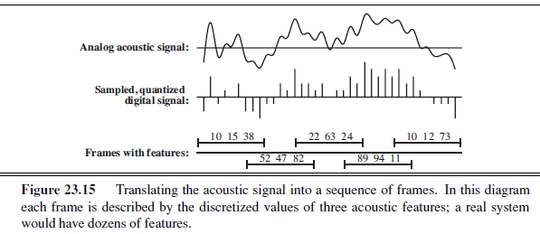
SPEECH RECOGNITION

Slide 3
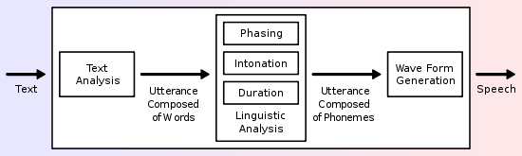
SPEECH SYNTHESIS
Overview of a typical TTS system

Slide 4
LANGUAGE MODELS
Formal languages, such as the programming languages Java or Python, have precisely defined language models.
Natural languages, such as English or Spanish, cannot be characterized as a definitive set of sentences.
That is, rather than asking if a string of words is or is not a member of
the set defining the language, we instead ask for P(S =words )
Natural languages are also ambiguous
Finally, natural languages are difficult to deal with because they are very large, and constantly changing.

Slide 5
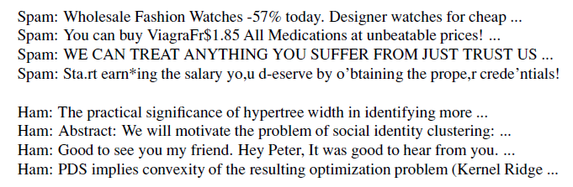
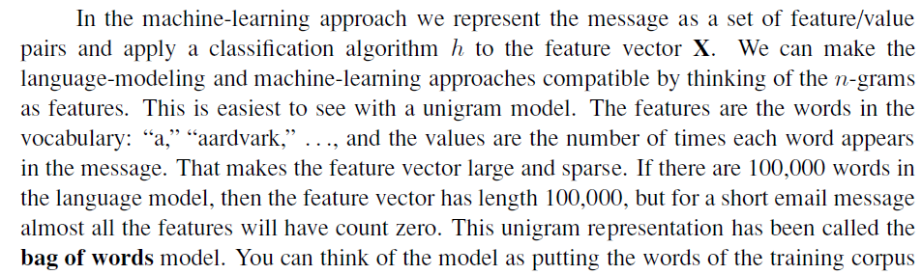
TEXT CLASSIFICATION
Consider the task of text classification, also known as categorization: given
a text of some kind, decide which of a predefined set of classes it belongs to.
The term ham for not-spam
We can classify a new message with an application of Bayes’ rule

Slide 6
INFORMATION RETRIEVAL
Information retrieval is the task of finding documents that are relevant to a user’s need for information. The best-known examples of information retrieval systems are search engines on the World Wide Web.
The earliest IR systems worked on a Boolean keyword model. Each word in the document
collection is treated as a Boolean feature that is true of a document if the word occurs in the
document and false if it does not.
The query language is the language of Boolean expressions over features.

Slide 7

INFORMATION RETRIEVAL IR scoring functions
A scoring function takes a document and a query and returns a numeric score; the most
relevant documents have the highest scores.
BM25 is a bag-of-words retrieval function that ranks a set of documents based on the query terms appearing in each document, regardless of the inter-relationship between the query terms within a document (e.g., their relative proximity). It is not a single function, but actually a whole family of scoring functions, with slightly different components and parameters. One of the most prominent instantiations of the function is as follows.
Given a query , containing keywords , the BM25 score of a document is:

Slide 8
INFORMATION RETRIEVAL IR system evaluation
Precision measures the proportion of documents in the result set that are actually relevant.
Recall measures the proportion of all the relevant documents in the collection that are in the result set.

Slide 9
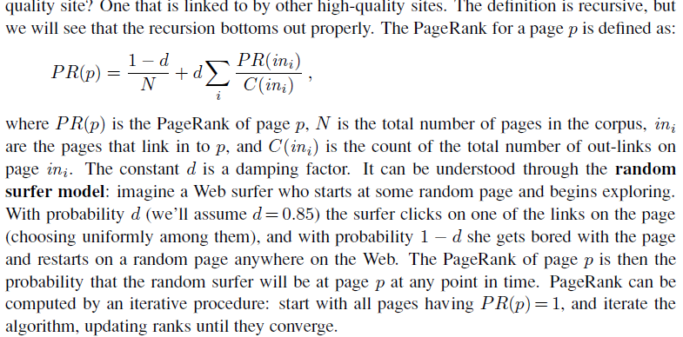
INFORMATION RETRIEVAL The PageRank algorithm
PageRank3 was one of the two original ideas that set Google’s search apart from other Web
search engines when it was introduced in 1997.
PageRank was invented to solve the problem of the tyranny of TF (term frequency) scores: if the query is [IBM], how do we make sure that IBM’s home page, ibm.com, is the first result, even if another page mentions the term “IBM” more frequently? The idea is that ibm.com has many in-links (links to the page), so it should be ranked higher:

Slide 10
INFORMATION EXTRACTION
Information extraction is the process of acquiring knowledge by skimming a text and looking for occurrences of a particular class of object and for relationships among objects. A
typical task is to extract instances of addresses from Web pages, with database fields for
street, city, state, and zip code; or instances of storms from weather reports, with fields for
temperature, wind speed, and precipitation.
The simplest type of information extraction system is an attribute-based extraction system
that assumes that the entire text refers to a single object and the task is to extract attributes of
that object.
One step up from attribute-based extraction systems are relational extraction systems
A relational extraction system can be built as a series of cascaded finite-state transducers. That is, the system consists of a series of small, efficient finite-state automata (FSAs), where
each automaton receives text as input, transduces the text into a different format, and passes
it along to the next automaton.

Slide 11
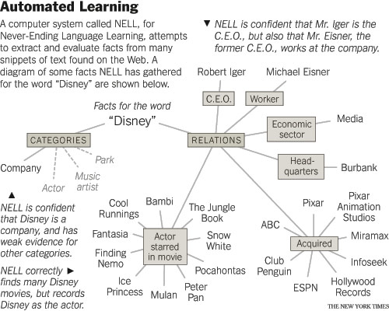
INFORMATION EXTRACTION Ontology extraction from large corpora
Never-Ending Language Learning: http://rtw.ml.cmu.edu/rtw/

Slide 12
I looked up; through the transparent canopy I could see a smooth, polished wall and, far above, Moddard's head leaning over the top of the shaft.
Podniósłszy oczy, zobaczyłem przez wypukłą szybę ściany studni i, wyżej, schyloną nad nią twarz Moddarda.
Подняв глаза, я увидел сквозь выпуклое стекло стены колодца и выше лицо склонившегося над ним Моддарда.
Pakėlęs akis, pro išgaubtą šulinio sienos langą pamačiau pasilenkusio Modardo veidą.
He lifted up his eyes and saw the convex glass walls of the well and, above, bent over her face Moddarda (PL)
Looking up, I saw through the convex glass wall well above the face bending over him Moddarda . (RU)
I lifted up my eyes, concave pit wall through the window I saw the face of Medardo pasilenkusio. (LT)
PE ->
I VP; through NP I VP
(subclass Looking Seeing)
I glanced up; through the window I could see
VP
Looking
Increasing
(=> (and
(instance ?SEE Seeing)
(patient ?SEE ?OBJ))
(holdsDuring (WhenFn ?SEE) (attribute ?OBJ Illuminated)))
I peeked up; through the frame I could see
PL ->
VP3, pro NP VBD4
I glinted up; through the period I could see
VP ->
VBD PRT
VP3 ->
VBP41 NNS1
NP
Transparent
Artifact
(=>
(attribute ?O Transparent)
(modalAttribute
(exists (?S) (and
(instance ?S Seeing)
(agent ?S ?A)
(destination ?S ?D)
(between ?O ?A ?D))) Possibility))
VBD ->
looked | …
VBP41 ->
pakėlęs | …
VP
Seeing

Slide 13

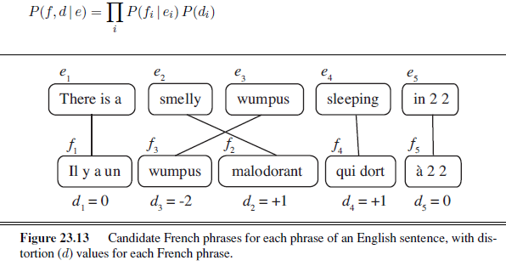
MACHINE TRANSLATION

Slide 15

LANGUAGE MODELS . N-gram character models
An n-gram model is defined as a Markov chain of order n − 1.
Trigram model
We can define the probability of a sequence of characters P(c1:N) under the trigram model
by first factoring with the chain rule and then using the Markov assumption

Slide 16
LANGUAGE MODELS . N-gram character models (Lietuvių kalba)
6 žodžių frazės , kurios prasideda žodžiu studentas
studentas sukurtų po temą apie tarkime 34
studentas turėtų pakankamų žinių ir gebėjimų 19
studentas šiandien sąrašas daugiau nei šimtu 14
studentas gali pasirinkti kur nori studijuoti 13
studentas turi atvyti keletui dienų į 13
studentas norėdamas gauti socialinę stipendiją 2 12
studentas į paprastą pragarą o ten 11
studentas krepšelį praras jei jo vidurkis 11
studentas norintis gauti paskolą turi registruotis 11
studentas į studentišką pragarą o ten 10

Slide 17
LANGUAGE MODELS . N-gram character models (Anglų kalba)
4 žodžių frazės , kurios prasideda žodžiu student
student council national block 5379
student conference on medical 3414
student showcase finalist tag 2983
student help and other 2963
student council location miss 2051
student version adobe creative 1860
student teacher or parent 1641
student promoter home wrecker 1584
student is attending any 1442
student however innocuous it 1289

Slide 18
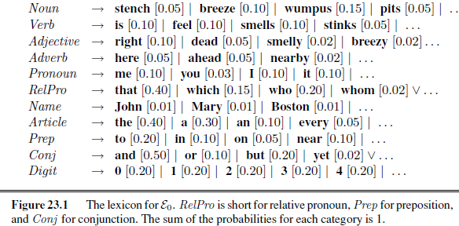
PHRASE STRUCTURE GRAMMARS

Slide 19
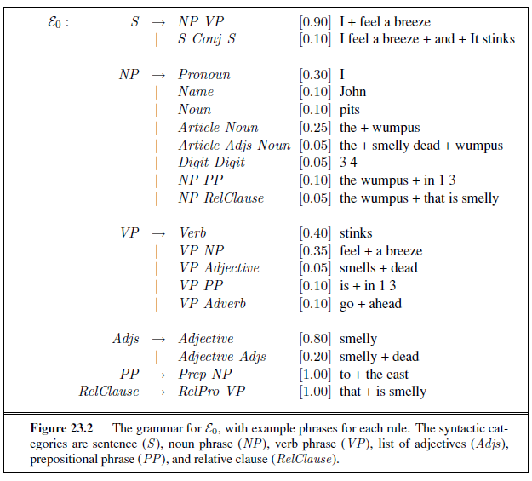
PHRASE STRUCTURE GRAMMARS

Slide 20
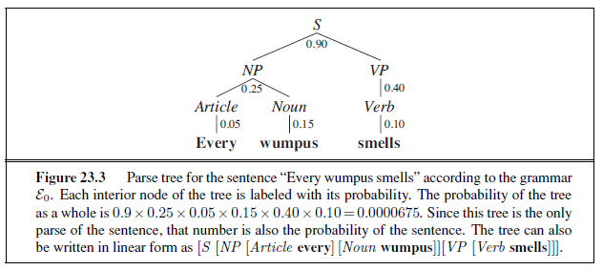
PHRASE STRUCTURE GRAMMARS

Slide 21
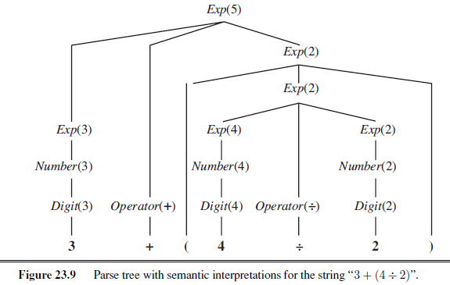
Semantic interpretation

Slide 22
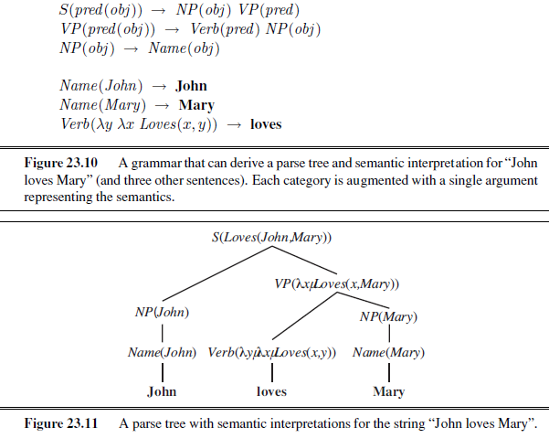
Semantic interpretation

